Slide 1
Bluetooth, Wi-Fi and Wi-Max
Notes:
Let’s move on to wireless access technology area and try to understand technologies such as BlueTooth, Wi-fi and Wi-max at an abstract level…

Slide 2
Objectives
At the end of this session, you will be able to:
  Classify IEEE wireless standards along with their range of operations
  Understand bluetooth network at a very conceptual level
  Understand Wi-Fi andWi-Max network from a perspective of network composition, working and applications
  Compare Wi-Fi and Wi-Max network
CONFIDENTIAL© Copyright 2008 Tech Mahindra Limited

Slide 3
Agenda
IEEE wireless standards
Bluetooth
Wi-Fi
Wi-Max
Comparison of Wi-Fi and Wi-Max
CONFIDENTIAL© Copyright 2008 Tech Mahindra Limited

Slide 4
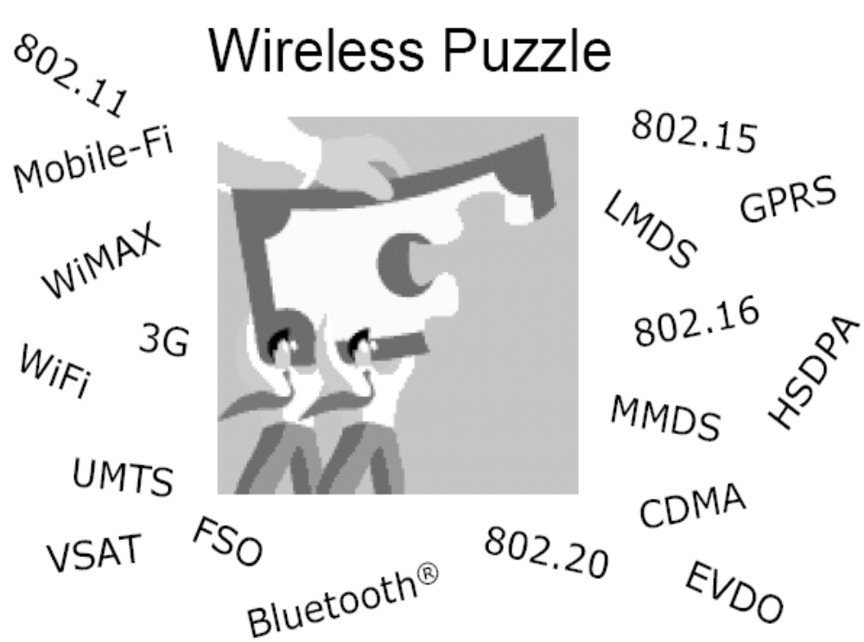
Wireless Puzzle
CONFIDENTIAL© Copyright 2008 Tech Mahindra Limited
Notes:
The wireless Puzzle !!!
There are lot of jargens and standards in the wirelss access areaad.
Some of them have been depicted in this area like….VSAT, Bluetooth , 8o2.15 , 802.11 , gprs , wi-max , umts etc…

Slide 5
IEEE Wireless Standards
WAN (Mobile)
802.20
MAN (Metro)
802.16
LAN (Local)
802.11
PAN (personal)
802.15
Wi-Max: 802.16
Wi-Fi: 802.11a/b/g
Bluetooth: 802.15
CONFIDENTIAL© Copyright 2008 Tech Mahindra Limited
Notes:
Wireless standards ….
IEEE has specified different standards in …different access areas …This is a pictorial representation of different wireless technology standards…
The picture shows that …how range and …coverage various across various IEEE wireless standards…
The standard which works at smallest range and coverage is PAN …I.e. personal aread network…it is also called as WPAN…Bluetoothe operates in this area..Technically this standard is known as eight o two dot fifteen…
Moving up the chain…wireless lan network which is also called as Wi-Fi. Where IEEE 802.11 standard flavors are operating …
Is is also called WLAN ..Wireless LAN…
Then we have Wirelss Man network …or so called WMAN…It is also called as Wi-Max standard…and IEEE standard is 802.16 …
And above it the WWAN I.e. Wireless WAN where IEEE standard eight o two dot twenty is present

Slide 6
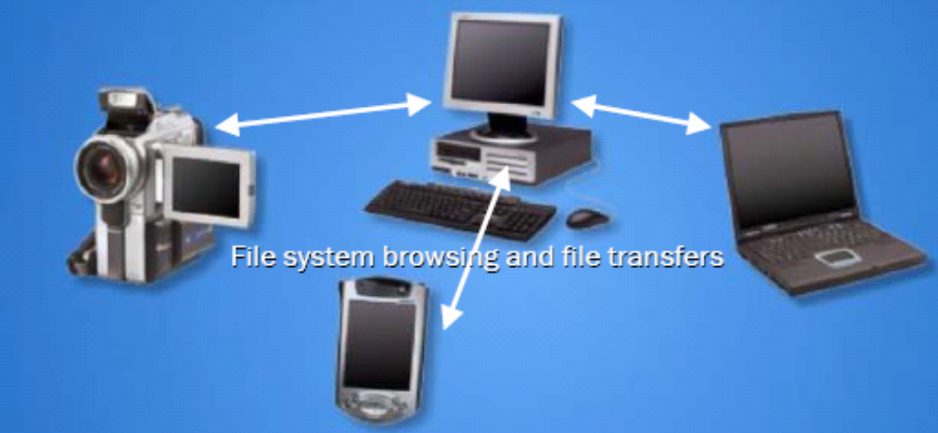
Bluetooth Technology
Bluetooth wireless technology is a short-range communications technology intended to replace the cables connecting portable and/or fixed devices while maintaining high levels of security.
Works in unlicensed spectrum
Standard
  IEEE 802.15
CONFIDENTIAL© Copyright 2008 Tech Mahindra Limited
Notes:
Blue tooth technology ….
Bluetooth is a wireless technology
It’s a short-range communications technology…intended to replace the cables connecting portable and/or fixed devices while maintaining high levels of security.
..Used by mobiles devices such as phones , computers and PDAs
Blue tooth predominantly operates in the unlicensed spectrum of 2.45 Ghz Freq band
The diagrams shows how blue tooth enables devices such as C< laptop, PDA and handicam interact with each other
IEE Standard for blue tooth is IEEE 802.15

Slide 7
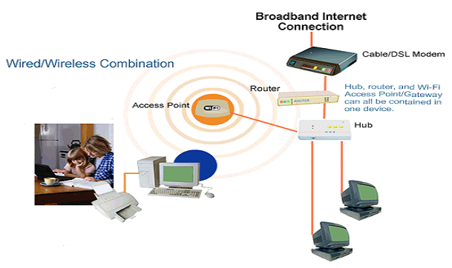
Wi-Fi
Wi-Fi (Wireless Fidelity) is a generic term that refers to the IEEE 802.11 communications standard for Wireless Local Area Networks (WLANs)
Wi-Fi Network connect computers to each other, to the internet & to the wired network
Uses licensed & un-licensed spectrum based on range
Standards
  IEEE 802.11a
  IEEE 802.11b
  IEEE 802.11g
CONFIDENTIAL© Copyright 2008 Tech Mahindra Limited
Notes:
Now we move onto another wireless standard called Wi-FI…
Wi-Fi is an acronym of Wireless Fidelity
Wi-Fi is a generic term that refers to the IEEE 802.11 communications standard for Wireless Local Area Networks (WLANs).
Wi-Fi Network connect computers to each other, to the internet and to the wired network.
Wi-Fi uses licensed and un-licensed spectrum based on range.
The different Standards are …IEEE 802.11a … IEEE 802.11b and IEEE 802.11g
Primarily, IEEE 802.11b and IEEE 802.11g are being higly used in the market…
As the diagram depcits … wirered network connected to Internet is connected to the wirelss wi-fi world through Access Point which is as if acting like a brings between wirelss and wireline network
…Wi-fi enabled network can access other wi-Fi devices or wireed network devices through this Access Point…

Slide 8
Elements of a WI-FI Network
Access Point (AP) - A wireless LAN transceiver or “base station” that can connect one or many wireless devices simultaneously to the Internet
Wi-Fi cards - Accept wireless signals & relay information. They can be internal and external. (e.g PCMCIA Card for Laptop and PCI Card for Desktop PC)
Safeguards - Firewalls and anti-virus software protect networks from uninvited users and keep information secure.
CONFIDENTIAL© Copyright 2008 Tech Mahindra Limited
Notes:
Elements of Wi-Fi network ….
There are primarily three elements of Wi-Fi network …First one amongst them is an access point
Access Point or AP is a wireless LAN transceiver or “base station” that can connect one or many wireless devices simultaneously to the Interne
Second element is a wi-card card …They accept the wireless signal and relay information….They can be internal and external ….e.g PCMCIA Card for Laptop and PCI Card for Desktop PC ….
Then the third element is Safeguards ….Firewalls and anti-virus software protect networks from uninvited users and keep information secure.

Slide 9
How a Wi-Fi Network Works?
Basic concept is same as Walkie talkies
A Wi-Fi hotspot is created by installing an access point to an internet connection
An access point acts as a base station
When Wi-Fi enabled device encounters a hotspot the device can then connect to that network wirelessly
A single access point can support up to 30 users and can function within a range of 100 – 150 feet indoors and up to 300 feet outdoors
Many access points can be connected to each other via Ethernet cables to create a single large network
CONFIDENTIAL© Copyright 2008 Tech Mahindra Limited
Notes:
Now let’s try to understand ‘How a Wi-Fi network works’ ?
Basic concept is same as Walkie talkies.
A Wi-Fi hotspot is created by installing an access point to an internet connection.
An access point acts as a base station.
When Wi-Fi enabled device encounters a hotspot the device can then connect to that network wirelessly.
A single access point can support up to 30 users and can function within a range of 100 – 150 feet indoors and up to 300 feet outdoors.
Many access points can be connected to each other via Ethernet cables to create a single large network.

Slide 10
Wi-Fi Applications
Home
Small Businesses or SOHO
Large Corporations & Campuses
Health Care
Wireless ISP (WISP)
Travellers
CONFIDENTIAL© Copyright 2008 Tech Mahindra Limited
Notes:
Different Wi-fi applications are mentioned here…
We can use it at home.. Small Businesses or SOHO …Large Corporations & Campuses …Health Care
Wireless ISP (WISP) …Travellers

Slide 11
Wi-Max
Worldwide Interoperability for Microwave Access
IEEE 802.16 standards-based wireless technology poised to be the next best thing
Aims to provide high-throughput wireless broadband connections over long distances
Fixed last-mile broadband access as a replacement or substitute for wired DSL, cable, or T1/E1 connections
Hotspot subscriber and backhaul provider connections supported
High-speed enterprise connectivity for business
IEEE 802.16-2000, fixed subscriber and provider backhaul standards; racing to production
IEEE 802.16e, mobility for subscribers, finalizing standards; racing to prototypes
CONFIDENTIAL© Copyright 2008 Tech Mahindra Limited
Notes:
Now we move on to the third wireless access technology called Wi-Max…
Wi max stands for ….Worldwide Interoperability for Microwave Access
It uses IEEE 802.16 standards-based wireless technology poised to be the next best thing
It Aims to provide high-throughput wireless broadband connections over long distances
Fixed last-mile broadband access as a replacement or substitute for wired DSL, cable, or T1/E1 connections
Hotspot subscriber and backhaul provider connections supported
High-speed enterprise connectivity for business
There are two different standards in Wi-max…
IEEE 802.16-2000 …. A standard for fixed subscriber and provider backhaul standards; racing to production
Then IEEE 802.16e, it is for ….mobility for subscribers, finalizing standards; racing to prototypes
These are two broad standards…

Slide 12
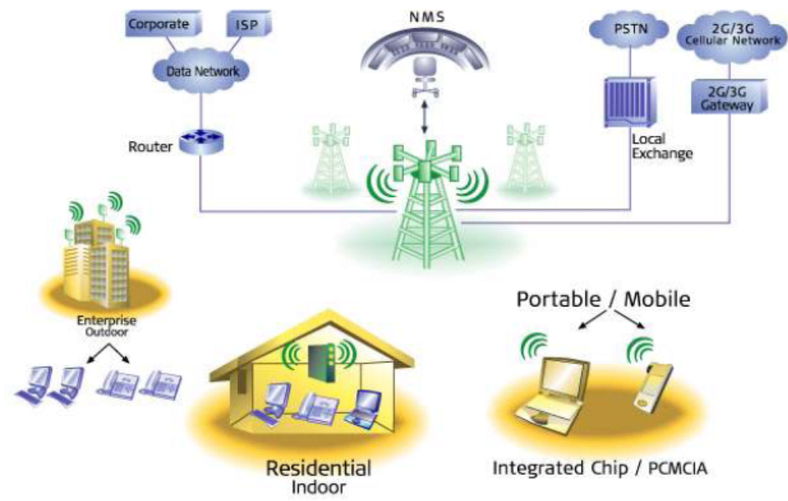
Wi-Max Architecture
CONFIDENTIAL© Copyright 2008 Tech Mahindra Limited
Notes:
Wi-Max architecture and different components involved in a Wi-Max network…
The core component of Wi-Max system is a subscriber station or othrwise know as CPE I.e Customer Premises Equipment..
In this diagram CPE is shown
Second component is a base station ..Base station and one or more subscriber stations or CPEs can form a cell…with point to multi-point structure…
Base station in this diagram is shown with the green tower present at the center of the diagram…
Apart from this different elements of network are shown over here…like …The network management system or so called NMS which is used to monitor the whole wi-max network…the Local exchange to which Wi-max base station can be connected …
Then 2G/3G gateway to which wi-max network is connected …
And wi-max network is connected to ISP Internet Service Provider through a router which is part of data network like TCP/IP …
So a typical Wi-Max architecture is represented in this diagram…

Slide 13
Wi-Max Features
Long Range, High Data Rate
Less susceptible to interference
Very viable mobile alternative to DSL and cable
Subscribers receive wireless broadband data delivery to the home
Plug and Play installation
CONFIDENTIAL© Copyright 2008 Tech Mahindra Limited
Notes:
Let’s have a look at Wi-max Features…
It provides long Range, High Data Rate…the range can be maximum upto maximum of 50 kms in a frequency range of 2 –11 GHz…
And data rate can reach upto 280 megabytes/per second…
Wi-max provides less susceptibility to interference…
Very viable mobile alternative to DSL and cable…
Subscribers receive wireless broadband data delivery to the home
And Plug and Play installation

Slide 14
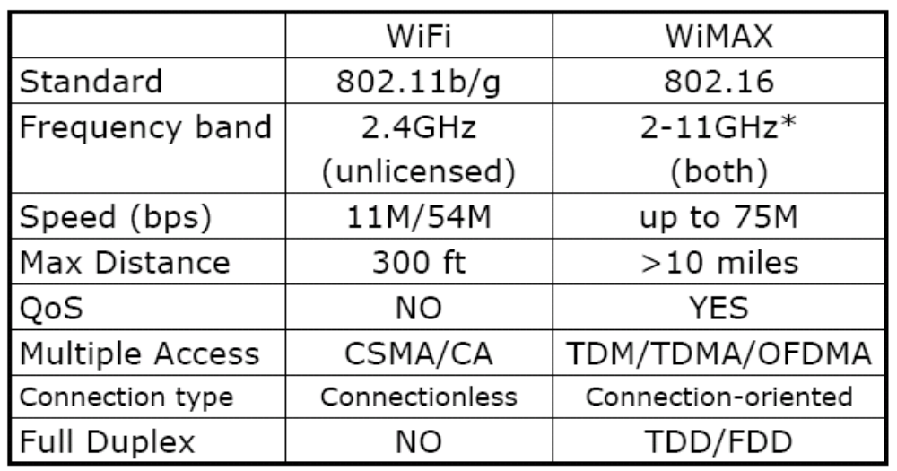
Wi-Fi and Wi-Max Comparison
CONFIDENTIAL© Copyright 2008 Tech Mahindra Limited
Notes:
Here goes a comparison between Wi-Fi and Wi-Max network….
Just read the table…
With this we come towards an end of the module ‘Wireless Access technology – Bluetooth , Wi-fi and Wi-Max’

Slide 15
Summary
In this session, we have learned:
  Classification IEEE wireless standards along with their range of operations
  Bluetooth network at a very conceptual level
  Wi-Fi andWi-Max network from a perspective of network composition, working and applications
  Comparison of Wi-Fi and Wi-Max network
CONFIDENTIAL© Copyright 2008 Tech Mahindra Limited

Slide 16
Thank You

